Slide 1

Introduction to Selenium WebDriver

Slide 2

Agenda
What is Selenium WebDriver?
Key Features of Selenium WebDriver
Setting Up Selenium WebDriver
Live Demo: Automating Google Search

Slide 3
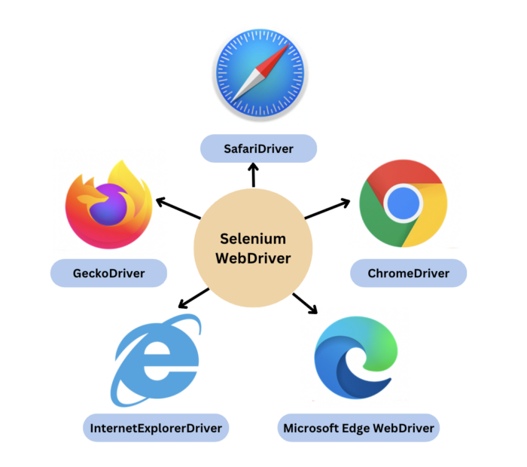
What is Selenium WebDriver?
Selenium WebDriver is a tool for automating web application testing.
It allows you to control a browser programmatically to simulate user interactions.
Supports multiple browsers (Chrome, Firefox, Safari, etc.) and programming languages (Python, Java, etc.).

Slide 4
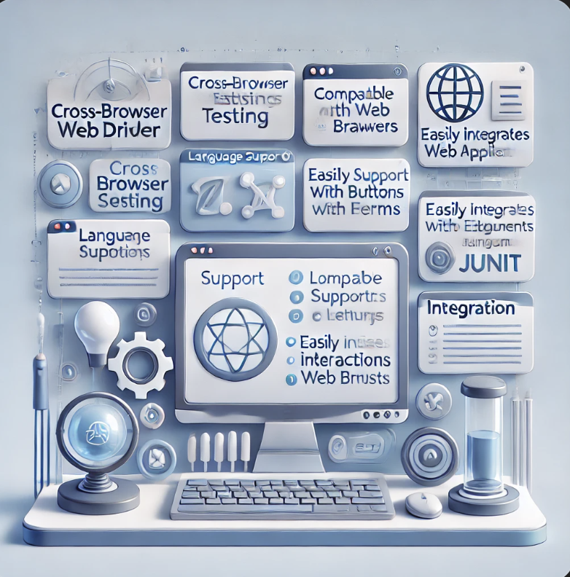
Key Features of Selenium WebDriver
Cross-Browser Testing: Test your web applications across multiple browsers.
Language Support: Compatible with many programming languages.
Element Interaction: Automate interactions with web elements like buttons, forms, and links.
Integration: Easily integrates with testing frameworks (e.g., PyTest, JUnit).

Slide 5
Setting Up Selenium WebDriver
Step 1: Install Python and pip.
python3 --version
pip3 --version
python3 -m ensurepip --upgrade
Step 2: Install Selenium using pip install selenium.
```pip install selenium``
Step 3: Download and install ChromeDriver.
```https://developer.chrome.com/docs/chromedriver/downloads```
Step 4: Write and execute a basic Selenium script.

Slide 6
Live Demo: Automating Google Search
Objective: Automate a Google search using Selenium WebDriver.
Steps:
Open Chrome browser.
Navigate to Google.com.
Perform a search for "Selenium WebDriver".
Verify that the search results page loads successfully.

Slide 7
Conclusion
Summary:
Selenium WebDriver is a powerful tool for automating web applications.
With a simple setup, you can create automated tests for various browsers.
The demo illustrated how to automate a basic Google search.

